Slide 1

Gradually interpretable models via component-wise boosting
Master Thesis
Lorenz Haller

Slide 2
Zusammenfassung der Arbeit
Mehrstufiges Verfahren unter Verwendung von Componentwise Boosting
Aktuell drei Phasen, hart voneinander getrennt:
Lineare Komponenten (lineares Modell)
Nicht-lineare Komponenten (über Splines)
Feature Interaktionen (Trees (oder zweidim. Splines denkbar))

Slide 3
Zusammenfassung der Arbeit
Übergang zwischen den Phasen über eine minimal notwendige Verbesserung des Risikos von einer Phase auf die nächste
ꜫ
Eine Phase läuft, solange der Quotient aus dem Risiko einer Iteration und dem Risiko aus der Iteration davor größer als ꜫ ist:
while((iteration <= mstop) & (risk[iteration-1]/risk[iteration] >= 1+ꜫ )){
…
}

Slide 4
Pseudo-Code: Initialisierung
interpretable_comp_boost_m <- function(data, formula, nu=0.05, mstop=200, family=Gaussian(), epsilon = 0.0025){
…
ngradient <- family@ngradient
riskfct <- family@risk
…
Fit intercept model as initial fit and calculate risk
intercept_model <- lm.fit(x=X[,1]), y=y)
fit_0 <- intercept_model$fitted.values
risk_0 <- riskfct(y = y, f = fitted_values)
lm_coeffs = numeric(dim(X)[2])
lm_coeffs[1] <- intercept_model$coefficients[1]

Slide 5
Pseudo-Code: Phase I Linear Models
while((iteration <= mstop) & ((risk[iteration-1]/[iteration]) >= (1 + epsilon))){
risk_temp <- riskfct(y = y, f = fitted_values)
u <- ngradient(y = y, f = fitted_values)
lm_coeffs_temp = numeric(dim(X)[2])
for(feat in 1:dim(X)[2]){
bl_model <- lm.fit(x=X[,feat], y=u)
lm_fit[feat] <- riskfct(y=u, f=bl_model$fitted.values)
pred_matrix[,feat] <- bl_model$fitted.values
lm_coeffs_temp[feat] <- bl_model$coefficients
}

Slide 6
Pseudo-Code: Phase I Linear Models
model_select <- which.min(lm_fit)
lm_coeffs[model_select] <- lm_coeffs[model_select] + nu * lm_coeffs_temp[model_select]
fitted_values <- X_scaled_lin %*% lm_coeffs
risk[iteration+1] <- riskfct(y = y, f = fitted_values)
}

Slide 7
Pseudo-Code: Phase II Splines
data_temp[,target] <- ngradient(y = y, f = fitted_values)
while((iteration <= mstop) & ((risk_temp / risk_iter[iteration+1]) >= (1 + epsilon))){
risk_temp <- riskfct(y = y, f = fitted_values)
u <- ngradient(y = y, f = fitted_values)
mb_spline = mboost::gamboost(formula = formula, data = data_temp, family = family, baselearner = "bbs", control = boost_control(nu = nu, mstop = 1))

Slide 8
Pseudo-Code: Phase II Splines
mboost_coeff = mb_spline$coef()[[1]]
mboost_risk = mb_spline$risk()[2]
coeff_list[[mboost_feature]] <- coeff_list[[mboost_feature]] + mboost_coeff
fitted_values <- fitted_values + mb_spline$fitted()
risk[iteration+1] <- riskfct(y = y, f = fitted_values)
data_temp[,target] <- ngradient(y = y, f = fitted_values)
}

Slide 9
Pseudo-Code: Phase III Trees
while((iteration <= mstop) & ((risk[iteration]/risk[iteration+1]) >= (1 + epsilon))){
risk_temp <- riskfct(y = y, f = fitted_values)
u <- ngradient(y = y, f = fitted_values)
mb_tree = mboost::mboost(formula = formula, data = data_temp, family = family, baselearner = "btree", control = boost_control(nu = nu, mstop = 1))
mboost_risk = mb_tree$risk()[2]
fitted_values <- fitted_values + mb_tree$fitted()
data_temp[,target] <- ngradient(y = y, f = fitted_values)

Slide 10
Pseudo-Code: Return List
return_list <- list()
return_list[["Coefficients"]] <- coeff_list
return_list[["Fitted_Values"]] <- fitted_values
return_list[["Transition Iterations"]] <-c(transition_splines,transition_trees)
return_list[["Risk"]] <- risk_iter
return_list[["Prediction_Models"]]<- c(linear_coefficients,spline_coefficients,tree_models)
return_list[["Input_Parameters"]] <-c(nu, mstop, epsilon)
return_list[["Riskfunction"]] <- riskfct
return(return_list)

Slide 11
Pseudo-Code: predict-Funktion
icb_predict <- function(icb_object, newdata, target){
prediction <- vector(mode = "numeric", length = dim(newdata)[1])
for (l in 1:length(prediction)){
prediction[l] <- icb_object$Coefficients$Intercept[[1]]
}
while(iteration <= (icb_object$`Transition Iterations`[1]+1)){
pred_iteration <- newdata[,selected_feature] * icb_object$Prediction_Models[[iteration]][pos_feature]
prediction <- prediction + nu * pred_iteration
test_risk[iteration+1] <- icb_object$Riskfunction(y = y, f = prediction) }

Slide 12
Pseudo-Code: predict-Funktion
while(iteration <= (icb_object$`Transition Iterations`[2]+1)){
mboost_spline_model <- icb_object$Prediction_Models[[iteration]]
pred_iteration <- mboost_spline_model$predict(newdata)
prediction <- prediction + pred_iteration
test_risk[iteration+1] <- icb_object$Riskfunction(y = y, f = prediction)
}
while(iteration < length(icb_object$Risk)){
mboost_tree_model <- icb_object$Prediction_Models[[iteration]]
pred_iteration <- mboost_tree_model$predict(newdata)
prediction <- prediction + pred_iteration
test_risk[iteration+1] <- icb_object$Riskfunction(y = y, f = prediction)
}

Slide 13
Pseudo-Code: predict-Funktion
return_list <- list()
return_list[["Predictions"]] <- prediction
return_list[["TestRisk"]] <- test_risk
return(return_list)
}

Slide 14
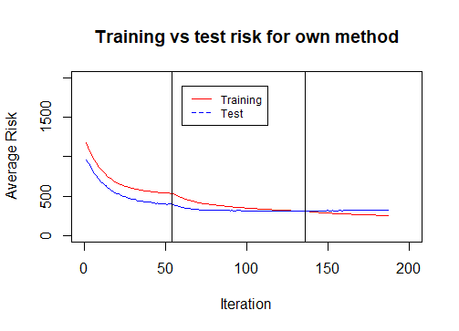

Slide 15
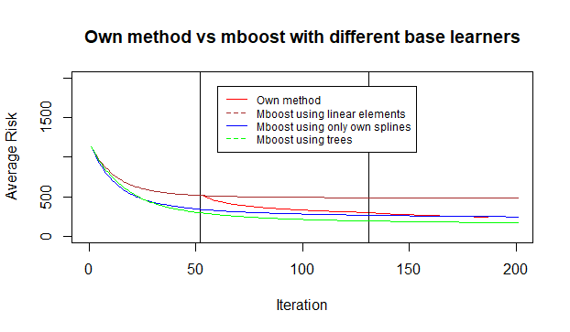

Slide 16

To-Do’s
Visualisierung verschiedener Kennzahlen im Verlauf der Zeit / des Risks: Anzahl der Features, Anzahl der Interaktionen, Nicht-Linearität der Effekte
Outputkurven zum Vergleich der Effekte über die drei Phasen
Partial Dependence Plots
Reduzierung der Größe der von mboost gespeicherten Daten/Modelle
Phase 0 mit Penalty für neue Features

Slide 17
Outline
Motivation:
Importance of Interpretability (so far mainly focus on accuracy…)
Demand for methods that combine accuracy and interpretability
2. Related Work:
„Technical“ Comparison to similar methods (Linear Model, Lasso, GA2M, GAMBoost, .. ) from practice and literature using different metrics (Performance, Sparsity, Interpretability)
3. Introduction to Gradient Boosting and Componentwise Boosting

Slide 18
Outline
Introduction of own method
Idea behind
Implementation Details (Three Phases/Steps, Choice of base learners, Stop Criterion)
Benchmark Study
Different data sets (Regression/Classification, Few/many features, Good/bad performance)
Different parametrizations of own method
Comparison to different other methods (that also adress the issue of interpretability?)

